Slide 1
OSI Reference model (Part 2)

Slide 2
Transport Layer
Segmentation
Sequencing and reassembling
Windowing, buffering, congestion avoidance
Error correction
Examples : TCP/UDP

Slide 3
Transport Layer
Identifying services
TCP
Connection oriented
Reliable
Protocol number 6
UDP
Connectionless
Unreliable
Protocol number 17
Difference between port number and protocol number

Slide 4
Network Layer
Dividing network topology into logical partitions
Logical Addressing
Path Discovery and Selection

Slide 5
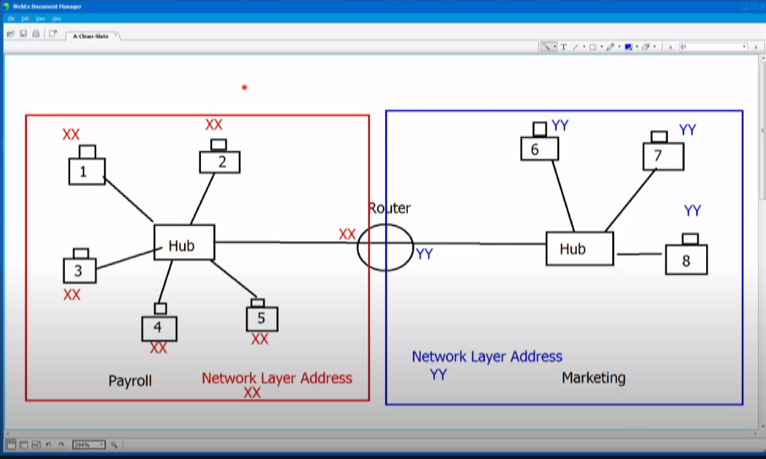
Network Layer

Slide 6
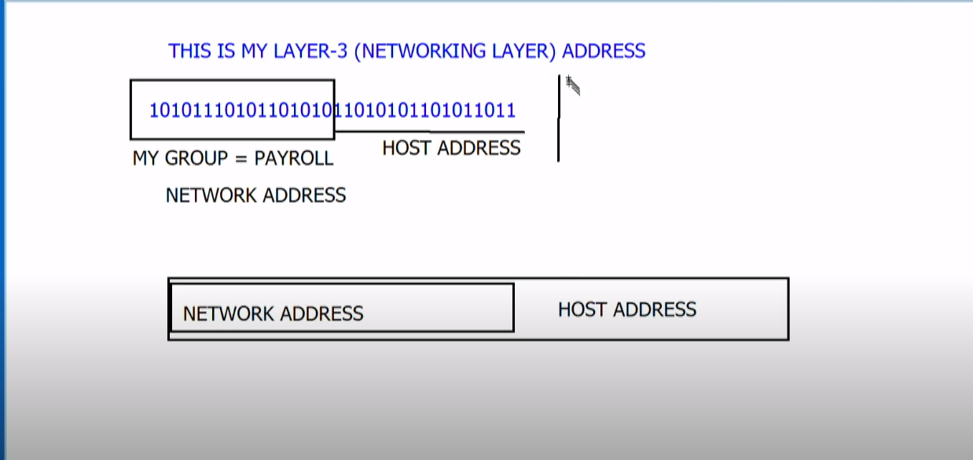
Network Layer

Slide 7
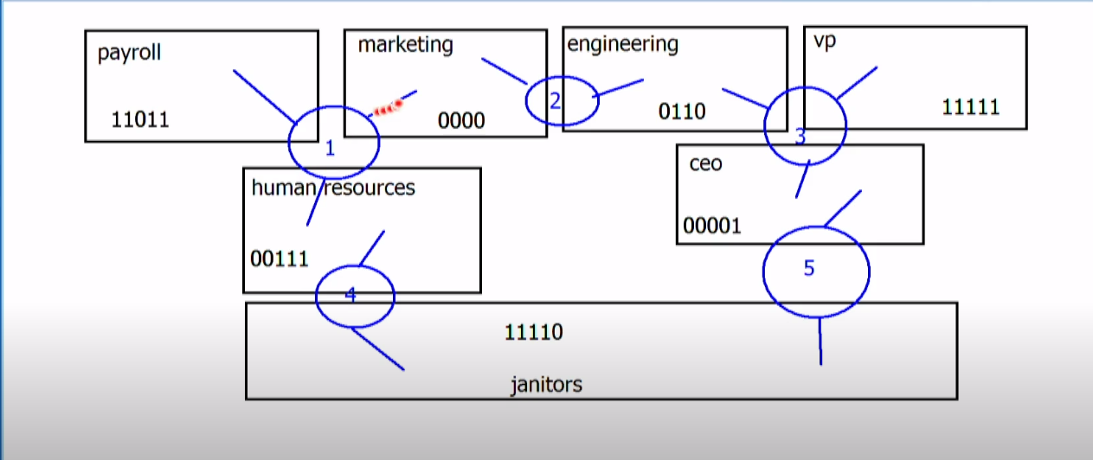
Network Layer
The work of network layer is to decide that where that network resides.
For Example in the router, the router has to decide if that network is reachable via it. That all is done by IP protocol.

Slide 8
Network Layer Terminology
Routed protocol
Protocols that are used for identification
• IP, IPX, AppleTalk
Routing protocol
Protocols that determine best paths for the routed protocols
• EIGRP, OSPF, etc.

Slide 9
Data Link Layer
Media-Access Control
This layer control if the device has to wait to send the data on wire or not.
Link-layer Addressing
It identified the device on layer 2.
Error Checking
Devices used at data link layer
Switches and bridges

Slide 10
Physical Layer
Electrical signals carried over the physical layer
Devices used at the physical layer
• Hubs
• Repeaters
• Network interface cards (NICs)
• Cables (Ethernet, fiber-optic, serial, etc.)

